Slide 1

Design THINKING
Unit 3B
Dr. Lakshmi S, Dept. of ECE

Slide 2
Prototype Phase
Students take their ideas and make them a reality, producing a prototype – an experimental model – that the end user can experience.

Slide 3
Prototype Phase
Few critical goals during prototyping:
Communicate clearly how the solution will solve the problem
Test, elicit feedback, identify new insights, and find unexpected failure points that can lead to improvements and refinements
Provide opportunities to problem-solve and think through ideas that may arise through the act of making

Slide 4
Prototype Phase
Few RULES during prototyping:
Do not get attached to your prototype
Do not consume too much time for making a prototype

Slide 5
Prototype Phase – Rapid prototyping
Create low-resolution prototype, and create it quickly
This enables you to gain feedback and learn failure points by building multiple prototypes

Slide 6
Prototype Phase – Rapid prototyping
https://youtu.be/d5_h1VuwD6g
TedYouth presentation, 2012 – Tom Chi, The co-founder of X

Slide 7
Prototype Phase – Prototyping in action
Driving question
Data collection at Empathize phase
Consolidation of observation
Identification of needs and insights
Definition of problem statement
Generate many ideas
Converge to one idea
Get a blueprint of idea
Brainstorm and improve on ideas
Create prototype
Decide on materials and tools
Decide on what user experience you are testing
Design control parameters and failure tests

Slide 8
Prototype Phase – Facilitation and Mentorship
Work in a team, and look for mentors who
Have time to spend with you
Are experts in the field
Are passionate about your problem statement
Have confidence in your design solution

Slide 9
Prototype Phase –Tools & materials
Hardware – Manufacturing tools, Electronic components, Wood/ plastic/ other materials
Software – Microcontroller programming, 3D design software
Remember safety is paramount! Cost restriction is practical!

Slide 10
Prototype Phase –Tools & materials
3D printing - https://youtu.be/-TDn25K-Jh4
User Interface designing - https://youtu.be/1c9LsuN3zVY
Electronics prototyping - https://youtu.be/HUVbGxMgu3E
Arduino for prototyping

Slide 11
Benefits of rapid prototyping
You can test the prototype several times in between
Failure of one prototype leads to quickly building one more
Low resolution prototype leads to testing preliminary models
Changes can be made in these preliminary models quickly
Goes through a prototype-testing iterative process
Early identification of flaws:
Helps catch potential issues early in the design process before investing significant resources.
Reduced development time:
Enables faster testing and iteration, leading to quicker product development cycles.
Improved user experience:
By gathering user feedback early, you can design products that better meet user needs.

Slide 12

Google glass

Slide 13
Google glass
Google Glass, or simply Glass, is a discontinued brand of smart glasses developed by Google's X Development (formerly Google X),^{[9]} with a mission of producing a ubiquitous (present everywhere)computer.^{[1]} Google Glass displays information to the wearer using a head-up display.^{[10]} Wearers communicate with the Internet via natural language voice commands.
Tom Chi, described the process of making the google glasses in his TedX talks
Took only one day for making the prototype of these glasses.
They used coat hanger, plexi glass, netbook, projector, for the first prototype
Next prototype added fishing lines, hair bands, binder clips and so on

Slide 14
Prototype Phase – Rapid prototyping
Chi’s three rules for prototyping
Find the quickest path to experience.
Doing is the best kind of thinking.
Use materials that move at the speed of thought to maximize your rate of learning.

Slide 15
Shower Timer design
Conserve Water by reducing shower times from 20 minutes to 10 minutes.
low res Protoype:
Large tank with water
Tiny nozzle made in the tank
Measure how much water flows out in five minutes using a timer
Once decided the volume of water, shut down the leak once time limit is reached.

Slide 16
Examples Of Rapid Prototyping In Aerospace
The aerospace industry has used various forms of rapid prototyping over the decades. It helps aerospace engineers to do several things:
3D Printed Satellites
Fleet Space, an Australian aerospace engineering company, started developing satellites using advanced 3D printing technology, one form of rapid prototyping.
Though the company is careful not to divulge too much information, the satellites will be groundbreaking regarding technological benefits and their low-cost manufacturing process.
The rapid prototyping approach also ensures that Fleet Space can identify potential faults and problems much sooner in the development stage, saving the engineers the effort and cost of additional troubleshooting later.

Slide 17
Rapid Prototyping To Build A Moon Base
Scientists and engineers on the International Space Station started experimenting with stereolithography(3D printing technology) in 2021 to test the viability of using rapid prototyping processes to build a moon base.
The experiments have progressed exceptionally well, meaning there’s a high possibility that humans can construct a moon base without having to send most of the materials pre-built from the earth.
Rocket launches are costly, even if we can re-use them, as SpaceX has been demonstrating, so sending all of the parts to construct a survival base on the moon (and potentially, much later, Mars) will cost a fortune.
Rapid prototyping, specifically 3D printing, will save governments and corporations a ton of money.

Slide 18
Airbus Reducing Aircraft Emissions Using Rapid Prototyping
Aircraft manufacturer Airbus recently started rapidly prototyping replacement parts for some existing planes.
The company’s engineers found that they could replace many of the current metallic components with rapidly prototyped replacements that weigh up to 70% less while offering identical performance.
It means that an Airbus aircraft’s weight can be reduced significantly, leading to less fuel use and, in the end, lower carbon emissions.

Slide 19
Medical Examples Of Rapid Prototyping
Strangely, the medical field is one of the most significant emerging industries when it comes to rapid prototyping, with scientists finding some excellent uses for the technology:
Training And Pre-Operation Preparation
Rapid prototyping enables teachers, professors, and lecturers to instantly create realistic and life-sized models of various human organs and limbs.
This is far beyond the old biological demo models we always see standing in life science classrooms.
Instead, the educator can create a replica of the specific organ, cell, or concept they are discussing at the time inexpensively and almost instantly.
Surgeons have also begun preparing for operations with rapidly prototyped models of the part of the anatomy they will perform a complex process on.
This improves their success rate considerably while not costing much money, improving the patient’s chances of recovery (not to mention their medical bill).

Slide 20
Manufacturing Replacement Body Parts
One of the most incredible applications of rapid prototyping in the medical field is transplants.
Some human organs don’t have to consist of biological matter. In particular, bone transplants, like hip and knee replacements, work well with rapidly prototyped parts.
Medical engineers can design an exact model that perfectly fits the patient’s body shape from MRI or CT-scan data, lowering the turn-around time and decreasing the possibility of error.

Slide 21
Rapidly Prototyping Dentures
Though few dentists are making use of rapid prototyping as much as they should, the potential is there.
Some are already doing amazing things by 3D printing sample sets of dentures, for example, to ensure that the fit is correct for patients.
CAD software can enable them to make changes instantly and test the updated dentures before manufacturing the final product.

Slide 22
Rapid Prototyping In Robotics And Mechanics
This may come as no surprise, but robotics and mechanical engineering have extensively used rapid prototyping for years, and it has revolutionized both industries.
Mechanical Engineering
Machines use moving parts and plenty of them. From gears and cogs to pistons and bolts, every aspect of a machine is crucial to make it function as it should.
There are two primary examples of how mechanical engineers use rapid prototyping:
Designing a mechanism. Rapid prototyping allows the engineer to save valuable time and resources by instantly making a new design model. They can use the model to test if their idea will work and how to change it to make it work better. They can see a real-world example of their design in action rather than trusting that their designs are flawless.
Replacing a part. If a machine breaks, finding a replacement for the damaged component could take time. Rapid prototyping changes this. In many cases, a mechanical engineer can draw up a design (or find a completed one) and use rapid prototyping to make a replacement part that temporarily fulfils the role.

Slide 23
Robotics
Robotics is all about making mechanical objects that can move autonomously.
As with mechanical engineering, rapid prototyping ensures that robotics engineers can get a model of their designs, test it, and make changes instantly.
For example, many schools implement their robotics curriculums using devices like Arduino boards to control the devices.
They then use different forms of rapid prototyping, like laser cutting and 3D printing, to make the device’s outer shell.
This allows students to get creative with their designs but immediately test and see if their plans will work.

Slide 24
Rapid Prototyping Examples In Civil Engineering
As with all the other forms of engineering, civil engineers also make extensive use of rapid prototyping.
Making Models Of Buildings
This part consists of teamwork between civil engineers, building contractors, and architects. It involves the process of rapidly prototyping a model of a building for two reasons:
To show the customer a demo of the architectural design, after which the customer can ask for changes to the plan.
To see potential flaws and drawbacks in the design so they can make changes instantly before the costly building project starts.

Slide 25
A significant area of concern in this regard is building a bridge.
Rapid prototyping, with proper weight and strength ratios, allows civil engineers to see if a bridge design will be strong enough to handle the weight of anticipated traffic.
Yes, plenty of mathematical calculations are involved as well, but nothing beats the experience of a model you can design and build rapidly.

Slide 26
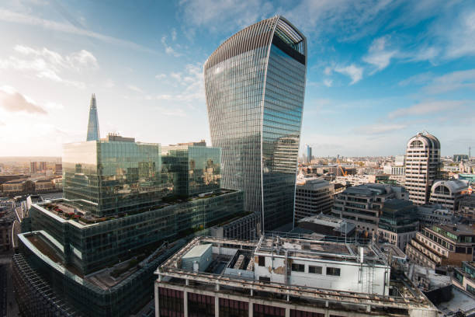
Walkie talkie centre London UK

Slide 27
“Walkie Talkie Centre” in London.
An example of why rapid prototyping is crucial for building projects is the so-called “Walkie Talkie Centre” in London.
The building has a unique design and look, which makes it a landmark in the city.
However, because the architects and engineers didn’t use proper rapid prototyping, the plan has two major flaws.
First, the building acts as a mirror that reflects sunlight down into the street below, causing temperatures of around 160°F. It’s hot enough to fry eggs or even melt parts of a car (which happened to a Jaguar parked in the street).
The owners had to install screens to block the reflection, which ruined the look that they were going for.
The second flaw is that the building’s curve and angle cause strong winds in the street, over and above the extreme heat.
These flaws could have been avoided if the architect had used proper rapid prototyping techniques to test the design before the construction started.

Slide 28
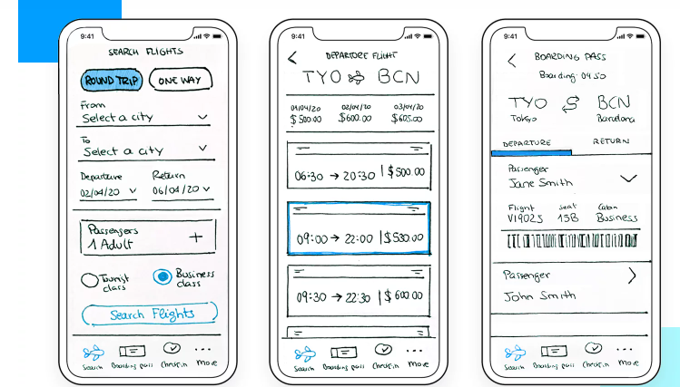
Paper prototyping

Slide 29
Paper prototyping a new product:
Design a basic physical model of a product using paper and cardboard to test its functionality and user interaction

Slide 30
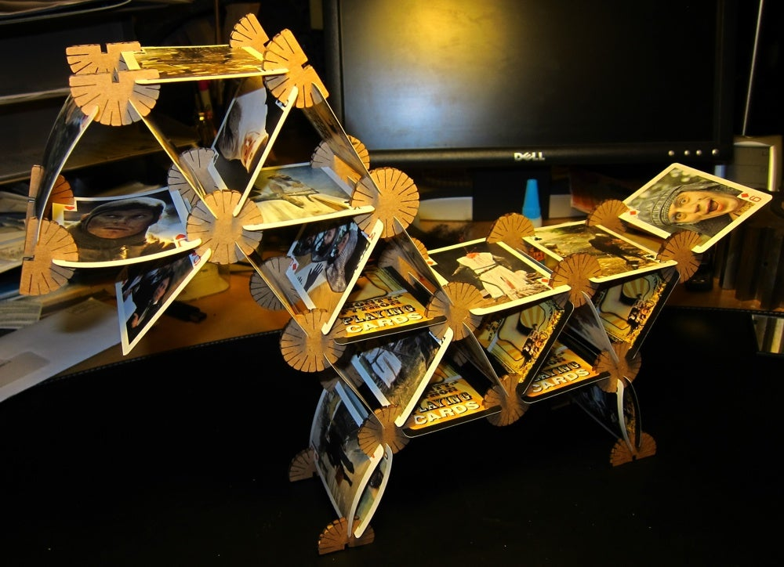
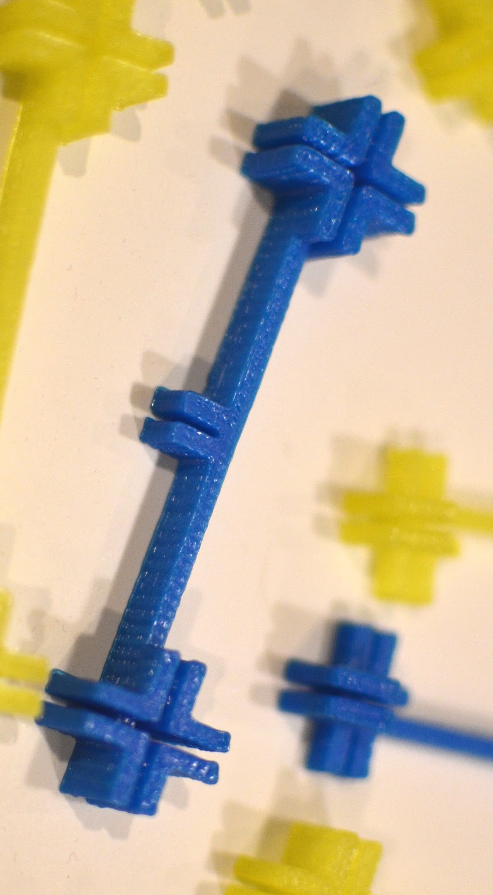
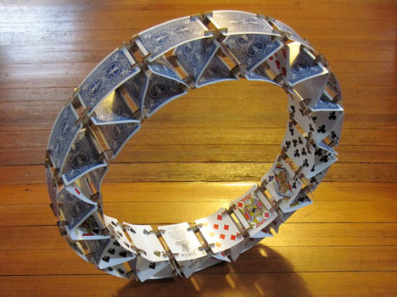
Prototype Phase –Activity
Don’t make any changes in the card. Design and prototype a connector and make 10 pieces of it.
In the next class we’ll test whose design is best by having a competition

